Slide 1
2.18.2020
Magenic Masters Live – Intro To Machine Learning
Kevin Ford
kevinf@magenic.com
617 359-5192

Slide 2
https://github.com/Magenic/MMLIntroToML

Slide 3
CIMON – IBM AI in space

Slide 4
Week 1
Different between AI and ML
PAAS and Custom ML
Machine Learning workflow
What is available from Watson, Azure and AWS
Week 1 readings and assignment

Slide 5
Week 2 - Azure
What services does Azure provide
Cognitive Services
LUIS
Facial Recognition
QnAMaker
Anomaly Detector
Week 2 readings and assignment

Slide 6
Week 3 - AWS
What services does AWS provide?
AI Series
Recommendations
Forecasting
Fraud Detection
Code
Week 3 readings and assignment

Slide 7
Week 4 – IBM Watson
What services does IBM Watson provide?
Watson Applications
Watson Discovery
Watson Personality Insights
Watson Knowledge Studio
Watson API Kit
Week 4 readings and assignment

Slide 8
Week 5 – Capstone – Building a BOT
BOT possibilities
Watson Assistant
AWS Conversational Agents
Azure Web App Bot
Deciding on a bot framework
Capstone assignment

Slide 9
What is Artificial Intelligence?
“The theory and development of computer systems able to perform tasks normally requiring human intelligence, such as visual perception, speech recognition, decision-making, and translation between languages.” - Oxford Dictionary
Machine learning is the part of AI that deals with programs that can self improve or “learn”.

Slide 10
Challenges & Weaknesses of AI
Require huge amounts of clean, accurate & contextual data
Tend to be task specific
Require lots of domain specific knowledge
Cannot handle nuance & causation
Black box

Slide 11
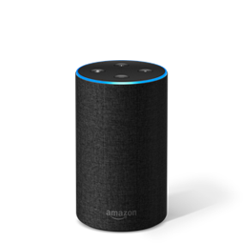

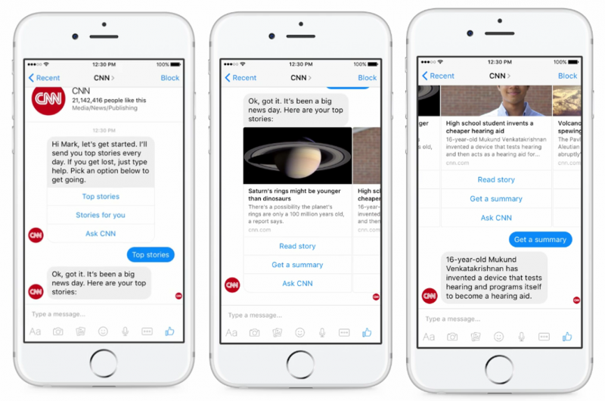
Common Uses in the Enterprise
Smart personal assistants
Anomaly Detection
Augmented Reality
Outcome Predictions
Security
Chatbots

Slide 12

Feature Extraction
Classification
Prediction
Model
Reinforcement Learning
Data Pre-Processing
What is the basic process?
Real World Results
Raw Data
Manual Process
The Magic
Training Data
Scoring Data

Slide 13
Key Terms
Feature Extraction
Classification
Training vs Scoring Data
Reinforcement Learning
Model
Notes:
Feature Extraction – Looking at raw data and pulling out items that may be used to recognize key features about that data that are relevant to understand it. With normal machine learning this is a manual process
Classification – This is where the magic happens. This is where a variety of statistical algorithms run and use the extracted features in different ways to attempt to answer questions about new and similar data that comes in.
Neural Networks – Networks that are designed to work like the human brain. The foundation of deep learning.
Reinforcement learning. – learning by trial and error the best ways to solve a problem
Model – is the product of feature extraction and classification. It can now be used to take newly input data and understand what it is based on the feature extraction and classification of data that has happened before. Reinforcement leaning can be used to improve the model over time.

Slide 14
How do we work with a model?
Problem Data (x)
Result (y)
Age
Gender
Model
Will they buy my product?
Income
Location
Y = fn(x)

Slide 15
Required ML Skills for Developers
Coding skills still required to interface with APIs
Understanding of data and how it works
Basic math and statistics skills
Know the algorithms and capabilities that are available
Notes:
Coding still required but you are accessing an API versus writing the logic to solve the problem. i.e. passing it a data model and getting back an answer or prediction.
Basic understanding of data and how it works.
Basic math and stats skills

Slide 16
Prepare for Ambiguity
41.23% Cat
43.3% Cat
35.41% Octopus
35.2% Octopus
23.36% Superman
21.5% Superman

Slide 17
Not All ML Tools are Easy

Slide 18
PAAS - Machine Learning
Traditional Machine Learning
Requires domain knowledge
Solves specific *common* problems
In many cases can still be trained
Azure Computer Vision vs Custom Vision
Does not require deep machine learning conceptual knowledge
Training wheels on
Requires domain knowledge
Can solve a wide variety of problems
Always requires training and design of the model
Requires deep machine conceptual knowledge
What are training wheels?

Slide 19
Why do we start with the service offerings?
What is a Sigmoid?
A
A
Logistic Regression
y = mx + b
A
B
B
B

Slide 20
Regression vs. Classification
X
A
A
A
B
B
B
?
Regression
Classification
What will be our revenues in 2023?
When will this part fail?
Is this a likely a buyer or not?
Does this X-Ray show a fracture?

Slide 21
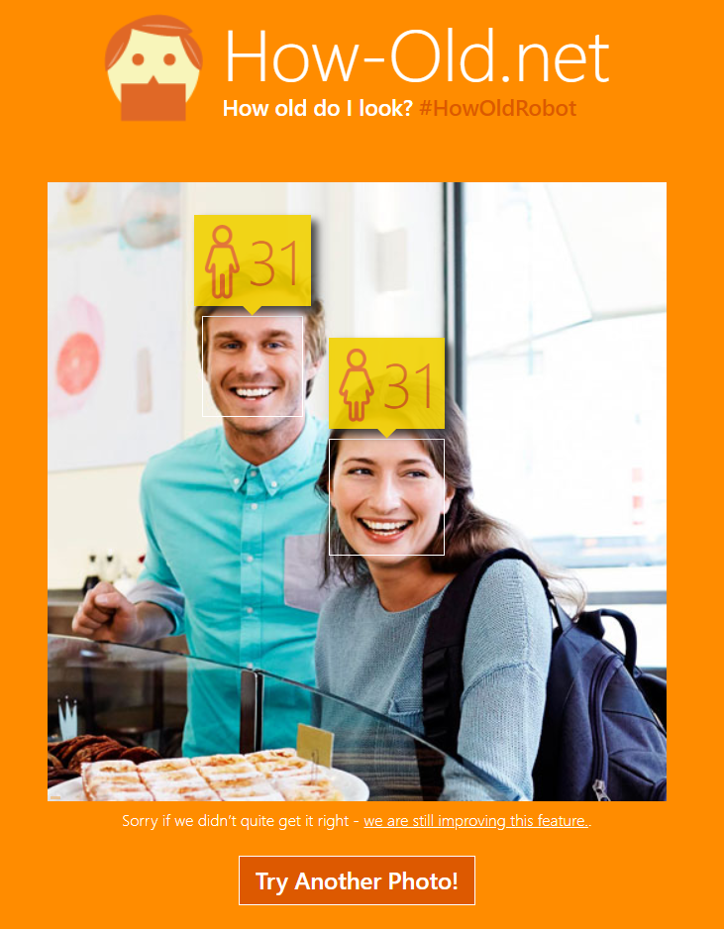
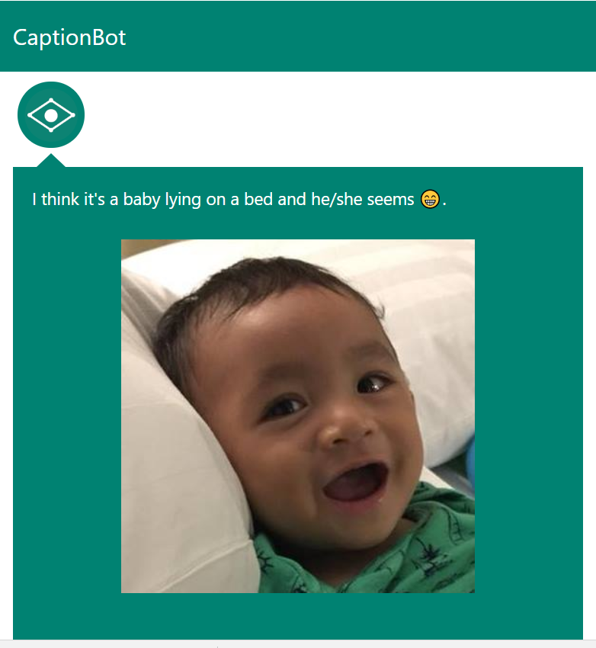
Demo one – Computer Vision REST API
https://How-Old.net
https://www.captionbot.ai/
Regression or Classification?
Notes:
How-Old.net is the demo site of Microsoft's Project Oxford

Slide 22
Dealing with data
Name | Age | Gender | Income | Location | Purchase
Billy B | 23 | M | 102K | Columbus, OH | N
Karen K | 54 | F | 32K | Newport, RI | Y
Jackie K | 12 | F | .1K | Columbus, OH | N
Kevin K | 34 | M | 59K | Columbus, OH | Y
Reggie R | 43 |  | 48K | Columbus, OH | Y
Mary M | 13 | F | .05K | Newport, RI | N
Vector
Matrix
Independent Variables (X)
Dependent Variable (Y)

Slide 23
Data Scrubbing – Feature Selection
Name | Age | Gender | Income | Location | Purchase
Billy B | 23 | M | 102K | Columbus, OH | N
Karen K | 54 | F | 32K | Newport, RI | Y
Jackie K | 12 | F | .1K | Columbus, OH | N
Kevin K | 34 | M | 59K | Columbus, OH | Y
Reggie R | 43 |  | 48K | Columbus, OH | Y
Mary M | 13 | F | .05K | Newport, RI | N
Independent Variables (X)
Dependent Variable (Y)

Slide 24
Data Scrubbing – Row Compression
Age | Gender | Income | Location | Purchase
23 | M | 102K | Columbus, OH | N
54 | F | 32K | Newport, RI | Y
12 | F | .1K | Columbus, OH | N
34 | M | 59K | Columbus, OH | Y
43 |  | 48K | Columbus, OH | Y
13 | F | .05K | Newport, RI | N
13 | F | .05K | Newport, RI | N

Slide 25
Data Scrubbing – One-Hot Encoding
Age | Gender | Income | Location | Purchase
23 | M | 102K | Columbus, OH | N
54 | F | 32K | Newport, RI | Y
12 | F | .1K | Columbus, OH | N
34 | M | 59K | Columbus, OH | Y
43 |  | 48K | Columbus, OH | Y
13 | F | .05K | Newport, RI | N
Age | Gender | Income | Location | Purchase
23 | 0 | 102K | Columbus, OH | N
54 | 1 | 32K | Newport, RI | Y
12 | 1 | .1K | Columbus, OH | N
34 | 0 | 59K | Columbus, OH | Y
43 |  | 48K | Columbus, OH | Y
13 | 1 | .05K | Newport, RI | N
Many calculations need to work with numeric data

Slide 26
Data Scrubbing –Location One-Hot Encoding
Age | Gender | Income | Location | Purchase
23 | 0 | 102K | Columbus, OH | N
54 | 1 | 32K | Newport, RI | Y
12 | 1 | .1K | Columbus, OH | N
34 | 0 | 59K | Columbus, OH | Y
43 |  | 48K | Columbus, OH | Y
13 | 1 | .05K | Newport, RI | N
Age | Gender | Income | Columbus | Purchase
23 | 0 | 102K | 1 | N
54 | 1 | 32K | 0 | Y
12 | 1 | .1K | 1 | N
34 | 0 | 59K | 1 | Y
43 |  | 48K | 1 | Y
13 | 1 | .05K | 0 | N
Age | Gender | Income | Location Id | Purchase
23 | 0 | 102K | 1 | N
54 | 1 | 32K | 2 | Y
12 | 1 | .1K | 1 | N
34 | 0 | 59K | 1 | Y
43 |  | 48K | 1 | Y
13 | 1 | .05K | 2 | N

Slide 27
Data Scrubbing – Binning
Age | Gender | Middle Class | Lower Class | Columbus | Purchase
23 | 0 | 0 | 0 | 1 | N
54 | 1 | 1 | 0 | 0 | Y
12 | 1 | 0 | 1 | 1 | N
34 | 0 | 1 | 0 | 1 | Y
43 |  | 1 | 0 | 1 | Y
13 | 1 | 0 | 1 | 0 | N
Age | Gender | Income | Columbus | Purchase
23 | 0 | 102K | 1 | N
54 | 1 | 32K | 0 | Y
12 | 1 | .1K | 1 | N
34 | 0 | 59K | 1 | Y
43 |  | 48K | 1 | Y
13 | 1 | .05K | 0 | N
Just because it is numeric does not mean it is relevant – sometimes the numeric information points to some feature that is relevant.
One way to measure middle class household income is between 25k-100k

Slide 28
Data Scrubbing – Missing Data
Age | Gender | Middle Class | Lower Class | Columbus | Purchase
23 | 0 | 0 | 0 | 1 | N
54 | 1 | 1 | 0 | 0 | Y
12 | 1 | 0 | 1 | 1 | N
34 | 0 | 1 | 0 | 1 | Y
43 |  | 1 | 0 | 1 | Y
13 | 1 | 0 | 1 | 0 | N
Median
Mode
Removal

Slide 29
Splitting Data
Age | Gender | Middle Class | Lower Class | Columbus | Purchase
23 | 0 | 0 | 0 | 1 | N
54 | 1 | 1 | 0 | 0 | Y
12 | 1 | 0 | 1 | 1 | N
34 | 0 | 1 | 0 | 1 | Y
43 | 1 | 1 | 0 | 1 | Y
13 | 1 | 0 | 1 | 0 | N
Training Data
Common Splits: 70/30 – 80/20
Test Data
Should be randomized

Slide 30
How much data do I need?
Quantity - Minimum of 10X number of records as features
However, as number of features increases the number of possible combinations of independent variables increases exponentially
Diversity - Ideal to have one record for every combination of independent variables
More combinations of independent variables - the more effective it will be in predicting the dependent variable
Type of algorithm impacts the ideal minimum amount of data

Slide 31
Underfitting vs Overfitting
Overfitting – The model has been made so specific that it is very good at predicting the test data but little else
Underfitting – The model is so general that it has difficulty in even accurately predicting the test data

Slide 32
Feature Extraction
Classification
Prediction
Model
Reinforcement Learning
Data Pre-Processing
Reminder, this is the process
Real World Results
Raw Data
Manual Process
The Magic
Training Data
Scoring Data

Slide 33
Homework Readings
Readings:
http://www.r2d3.us/visual-intro-to-machine-learning-part-1/
http://www.r2d3.us/visual-intro-to-machine-learning-part-2/
https://docs.microsoft.com/en-us/azure/cognitive-services/custom-vision-service/getting-started-build-a-classifier
https://docs.microsoft.com/en-us/azure/cognitive-services/custom-vision-service/test-your-model
https://docs.microsoft.com/en-us/azure/cognitive-services/custom-vision-service/getting-started-improving-your-classifier
https://docs.microsoft.com/en-us/azure/cognitive-services/custom-vision-service/use-prediction-api

Slide 34
Homework project
Create a custom vision service
Create a custom vision service in Azure
Gather a set of images to classify something. Cats and dogs, different types of trees, etc.
Train your model
Test your model
Deploy your model
Send me the API information and what your classifier tests

Slide 35
Q & A

